Slide 1
Developments to established dose-finding methodologies for application in trials with complex and innovative designs
Amit Patel
Supervisors: Prof. Lucinda Billingham, Dr. Kristian Brock

Slide 2
Dose-finding Trials
Aim:
To obtain the recommended phase II dose (RP2D)
Ethical Criteria:
Do not want to undertreat patients
Do not want to overtreat patients
Use as few patients as possible (efficiency)

Slide 3
Dose-finding Trials
Assumptions:
Drug will become more toxic as dose increases
(Higher chance of efficacy response as dose increases)
Dose Limiting Toxicities (DLTs; yes/no)
Determine RP2D based on a pre-defined target

Slide 4
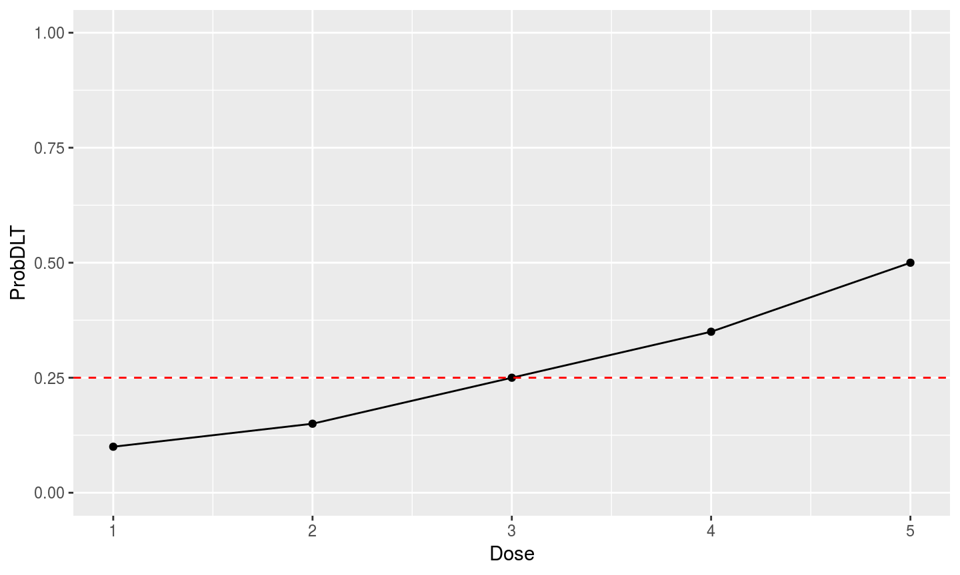
Dose-finding Trials

Slide 5
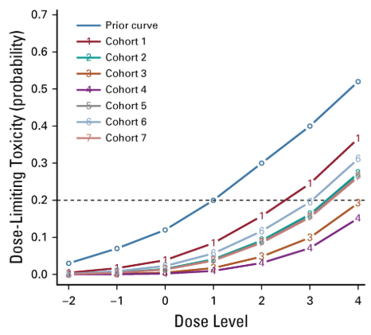
The Continual Reassessment Method

Slide 6
ADePT-DDR
Patient Population:
Patients with head and neck squamous cell carcinoma (HNSCC)
Intervention:
AZD6738
Radiotherapy dose 70Gy, delivered in 35F over 7 weeks
Objectives / Outcomes:
To evaluate the safety of AZD6738 in combination with Radiotherapy
Determine the recommended dose based on DLTs
Methodology:
Partial ordering time-to-event continual reassessment method
PO-TITE-CRM

Slide 7
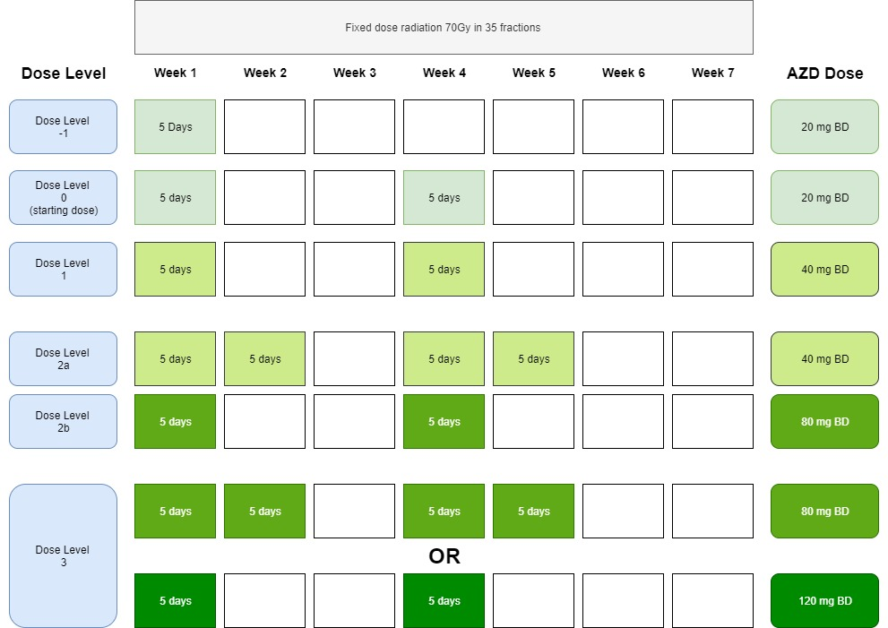
Trial Schema

Slide 8
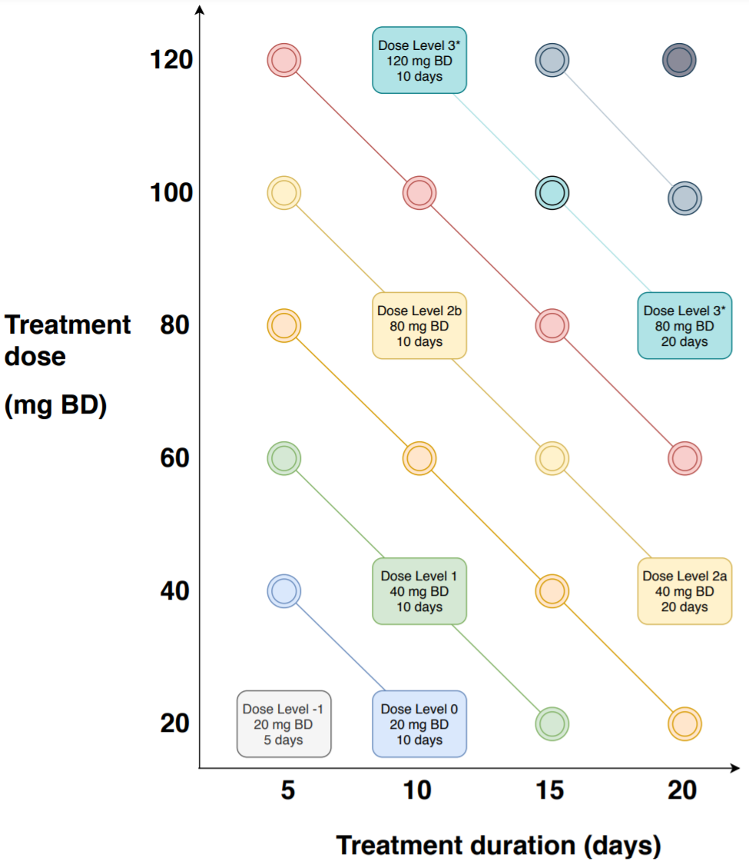
Dose Pathway

Slide 9
Ordering: Examples
Standard
10mg
20mg
50mg
100mg
250mg
Combinations
10mg of A + 100mg of B
10mg of A + 200mg of B
20mg of A + 200mg of B
50mg of A + 500mg of B
Dosing Schedule
10mg of A, one day per week
20mg of A, one day per week
20mg of A each day

Slide 10
Partial Ordering: Examples
10mg of A + 100mg of B
10mg of A + 200mg of B
5mg of A + 500mg of B
10mg of A + 750mg of B
?

Slide 11
Partial Ordering: Examples
10mg of A each day
20mg of A each day
100mg of A one day per week
?

Slide 12
Partial Ordering in ADePT-DDR
-1: 20mg each day, 1 week
0: 20mg each day, 2 weeks
1: 40mg each day, 2 weeks
2a: 40mg each day, 4 weeks
2b: 80mg each day, 2 weeks
3: 80mg each day, 4 weeks / 120mg each day, 2 weeks
?

Slide 13
CRM for Partial Orders
Used when the order of some doses is unknown
We have two possible orders here:
-1 -> 0 -> 1 -> 2a -> 2b -> 3
-1 -> 0 -> 1 -> 2b -> 2a -> 3
Each order has a dose toxicity model

Slide 14
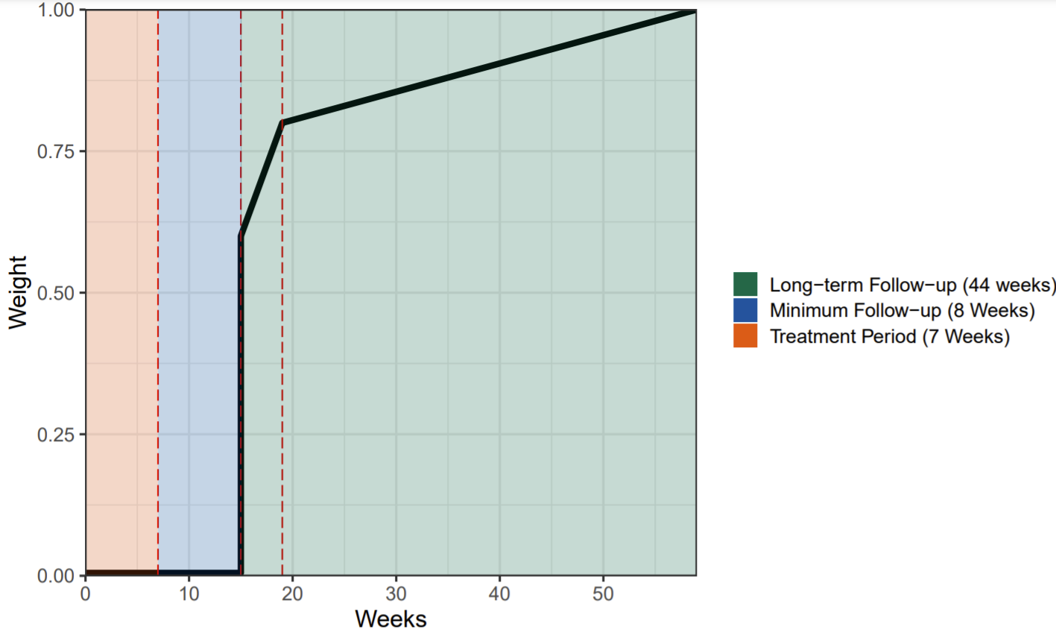
Time-to-event extension

Slide 15
Application
Both orderings are equally feasible
Target dose with 25% DLT probability
Two stage design:
Stage 1 – Follow a pre-defined dose escalation scheme if no DLTs occur
Stage 2 – Once a DLT is observed use the model to determine the next dose
Stopping rules:
Once 60 patients are recruited
Sufficient evidence that the RP2D is reached
Excess toxicity at the lowest dose

Slide 16
PhD Chapter
Mathematics of the design
Experiences implementing the design
Extensive simulation work

Slide 17
References
O'Quigley, J., Pepe, M., & Fisher, L. (1990). Continual reassessment method: a practical design for phase 1 clinical trials in cancer. Biometrics, 33-48.
Wages, N. A., Conaway, M. R., & O'Quigley, J. (2011). Continual reassessment method for partial ordering. Biometrics, 67(4), 1555-1563.
Wages, N. A., Conaway, M. R., & O'Quigley, J. (2013). Using the time‐to‐event continual reassessment method in the presence of partial orders. Statistics in medicine, 32(1), 131-141.

